Slide 1
RC4 Basics
A symmetric key encryption algorithm invented by Ron Rivest
  A proprietary cipher owned by RSA, kept secret
  Code released anonymously in Cyberpunks mailing list in 1994
  Later posted sci.crypt newsgroup
Variable key size, byte-oriented stream cipher
  Normally uses 64 bit and 128 bit key sizes.
Used in
  SSL/TLS (Secure socket, transport layer security) between web browsers and servers,
  IEEE 802.11 wirelss LAN std: WEP (Wired Equivalent Privacy), WPA (WiFi Protocol Access) protocol
Notes:
RC4 is a stream cipher designed in 1987 by Ron Rivest for RSA Security. It is a variable key-size stream cipher with byte-oriented operations. The algorithm is based on the use of a random permutation. Analysis shows that the period of the cipher is overwhelmingly likely to be greater than 10^100. Eight to sixteen machine operations are required per output byte, and the cipher can be expected to run very quickly in software. RC4 is probably the most widely used stream cipher. It is used in the SSL/TLS secure web protocol, & in the WEP & WPA wireless LAN security protocols. RC4 was kept as a trade secret by RSA Security, but in September 1994 was anonymously posted on the Internet on the Cypherpunks anonymous remailers list. In brief, the RC4 key is ued to form a random permutation of all 8-bit values, it then uses that permutation to scramble input info processed a byte at a time.

Slide 2
RC4-based Usage
WEP
WPA default
Bit Torrent Protocol Encryption
Microsoft Point-to-Point Encryption
SSL (optionally)
SSH (optionally)
Remote Desktop Protocol
Kerberos (optionally)

Slide 3

RC4 Block Diagram
Secret Key
RC4
Keystream
Plain Text
+
Encrypted
Text
Cryptographically very strong and easy to implement

Slide 4

RC4 …Inside
Consists of 2 parts:
  Key Scheduling Algorithm (KSA)
  Pseudo-Random Generation Algorithm (PRGA)
KSA
  Generate State array
PRGA on the KSA
  Generate keystream
  XOR keystream with the data to generated encrypted stream
KSA
PRGA

Slide 5


The KSA
Use the secret key to initialize and permutation of state vector S, done in two steps
Use 8-bit index pointers i and j
1
2
  for i = 0 to 255 do
    S[i] = i;
    T[i] = K[i mod(|K|)]);
  j = 0;
  for i = 0 to 255 do
    j = (j+S[i]+T[i])(mod 256)
    swap (S[i], S[j])
[S], S is set equal to the values from 0 to 255
  S[0]=0, S[1]=1,…, S[255]=255
[T], A temporary vector
[K], Array of bytes of secret key
|K| = Keylen, Length of (K)
Use T to produce initial permutation of S
The only operation on S is a swap;
S still contains number from 0 to 255
After KSA, the input key and the temporary vector T will be no longer used

Slide 6
The PRGA
Generate key stream k , one by one
XOR S[k] with next byte of message to encrypt/decrypt
  i = j = 0;
  While (more_byte_to_encrypt)
    i = (i + 1) (mod 256);
    j = (j + S[i]) (mod 256);
    swap(S[i], S[j]);
    k = (S[i] + S[j]) (mod 256);
    C_{i} = M_{i} XOR S[k];
Sum of shuffled pair selects "stream key" value from permutation

Slide 7
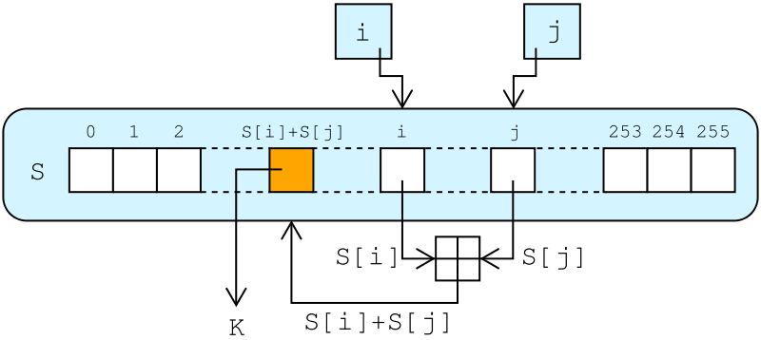
RC4 Lookup Stage
The output byte is selected by looking up the values of S[i] and S[j], adding them together modulo 256, and then looking up the sum in S
S [S[i] + S[j]] is used as a byte of the key stream, K
  i = j = 0;
  While (more_byte_to_encrypt)
    i = (i + 1) (mod 256);
    j = (j + S[i]) (mod 256);
    swap(S[i], S[j]);
    k = (S[i] + S[j]) (mod 256);
    C_{i} = M_{i} XOR S[k];
http://en.wikipedia.org/wiki/File:RC4.svg

Slide 8
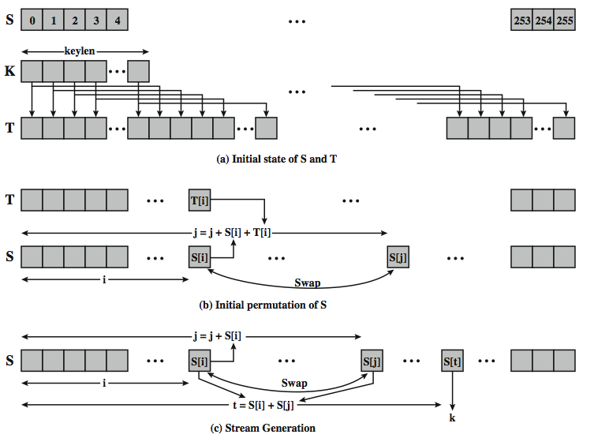
Detailed Diagram

Slide 9
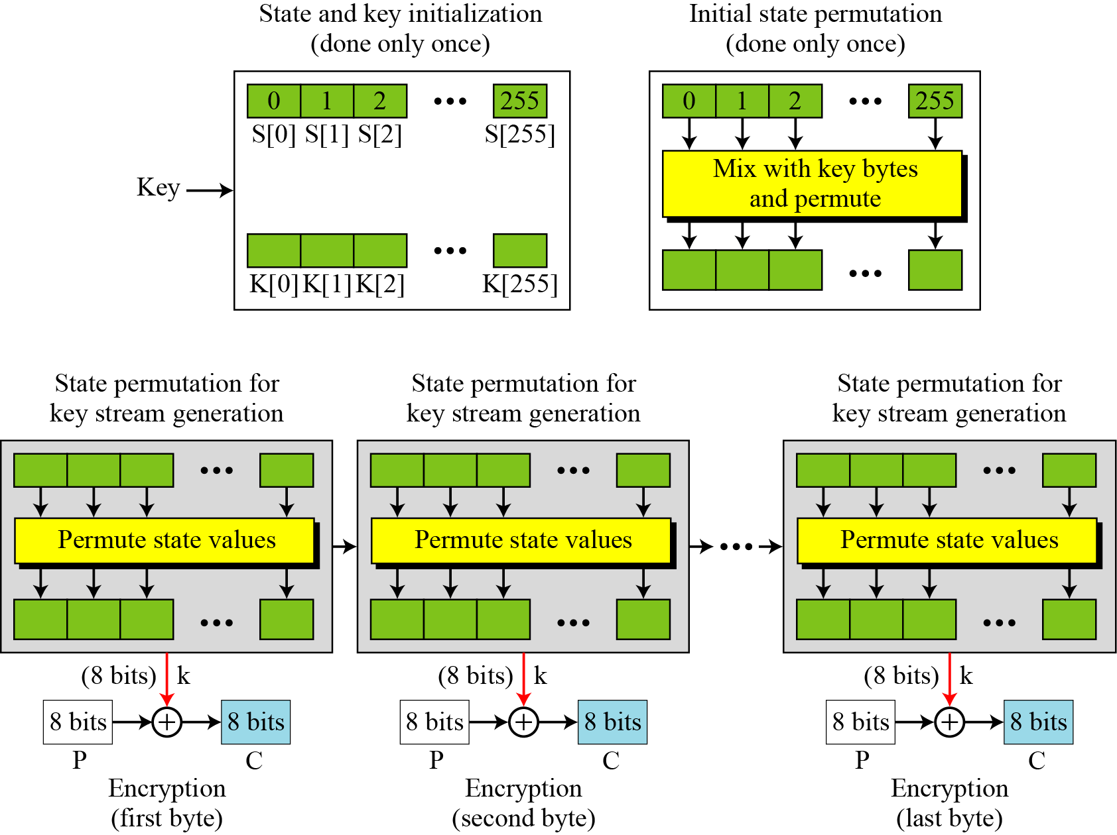
Overall Operation of RC4

Slide 10
Decryption using RC4
Use the same secret key as during the encryption phase.
Generate keystream by running the KSA and PRGA.
XOR keystream with the encrypted text to generate the plain text.
Logic is simple :
(A xor B) xor B = A
A = Plain Text or Data
B = KeyStream

